Slide 1

Steering Committee Support Presentation
SAP30/CMRL
On 20/10/2022

Slide 2
Agenda
Previous STEERCO decisions
Progress Status
Project performance
Budget review
Schedule review
Risk review
KPIs status
Required decisions
Change Requests Validation
Questions/Answers
Next Meetings

Slide 3
Previous STEERCO decisions
Decision 1
Master Data resource increase approval
Decision 2
CRM implementation approval in January 2023
Decision 3
Involvement of internal auditors in testing
Decision 4
Approval of external communication plan

Slide 4
Progress Status
Done
Parameterization and unit testing of domains
Finance
Sales
Purchasing
Logistics
Production
Master Data
Correction of identified issues
Datasets for integration testing
Preparation of integration / consolidation scenarios
To be done
Before integration tests
Review the scenarios and complete the examples
Distribute tests by user expertise
Finalize training materials
Before integration tests
Adapt the consolidation test plan
Confirm the training plan and send the invitations
Complete the tests to adapt them to the pre-production environment
Main difficulties encountered
Poor quality of certain data requiring a lot of correction work
Wide range of fixed assets
Important differences in chart of accounts
Product file to be cleaned

Slide 5
Project performance: Budget review simplified
Notes:
Possible de détailler la performance par services/périmètres. Par exemple splitter cet indicateur entre finances/logistique/achats etc.

Slide 6
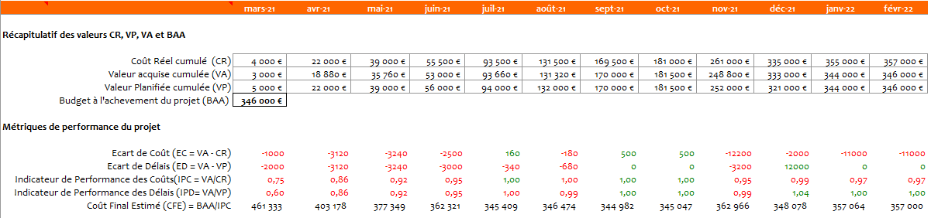
Project performance: Earned value analysis ½ *
See "Budget monitoring report" for more details

Slide 7
Project performance: Earned value analysis 2/2 *
See "Budget monitoring report" for more details

Slide 8
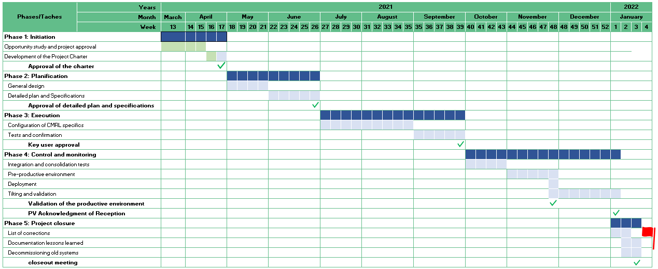
Performance de projet : Revue du Planning
Project performance: Schedule review
The movements of the past period :
Delivery of parameterized and tested systems in all areas of work
Data cleaning and corrections
Collection of interface requirements
Collection of CRM requirements
Validation by key users
Planned for the following period:
Integration test
Consolidation test
Finalized training materials
Detailed data failover plan
Detailed acceptance test plan for solutions in all areas of work
Preparation of the functional and operational changeover plan
Notes:
Possible de garder en référence la Baseline.
Et donc afficher le planning original et le planning réel, pour mettre en évidence les glissement de planning (en retard comme en avance d’ailleurs)

Slide 9
Project risk review
Description | severity | Probability | Criticality | Consequence if happens | Preventive Actions | Corrective Actions
Status-Quo | Catastrophic | Unlikely | Very critical | Cost, deadline, strategy | Start of the SAP CMRL project | Start of the SAP CMRL project
Control/Audit | Severe | Likely | Very critical | Cost and deadlines | Accelerated SAP implementation | Agreements with auditors
Lack of support or interest | Major | Unlikely | Critical | Deadlines and quality | Communication plan and assignment of a responsible change | Transparent communication
Dependencies between projects | Major | Likely | Critical | Cost, deadlines, strategy | SAP project and CMRL expansion project in the same portfolio | Change management
Deadline December 2023 | Major | Unlikely | Moderated | Cost, deadlines, strategy | Accelerated SAP implementation | Work during public holidays
* see "Risk register" for more details
Notes:
L’idée est de suivre l’évolution des risques tout au long du projet (Criticité, mesures préventives et correctives)

Slide 10
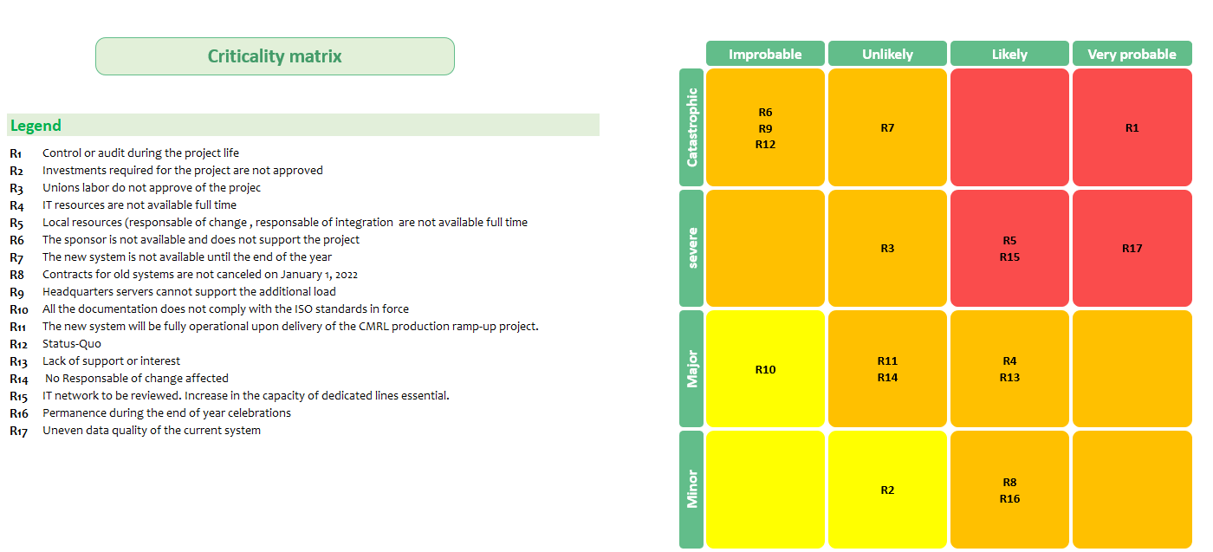
Project risk review: Risk matrix
* see "Risk register" for more details
Notes:
L’idée est de suivre l’évolution des risques tout au long du projet (Criticité, mesures préventives et correctives)

Slide 11
Evolution of the project KPIs
KPI | Target | Current status | Tendency | Comments
Implementation budget | 515 K euros | Satisfactory (Actual aligned with Planned) | Stable | On track
Annual operating cost | 310 K euros | Satisfactory (Project on schedule) | Improvement | Confidence increases with results
Removal of the 2 units assigned to daily corrections | Reassigned | Satisfactory (Huge corrective work) | Degradation | The cleaning work will go a long way in future efficiency
Commissioning | 6 months | Satisfactory (Project on schedule) | Improvement | The cleaning work will go a long way in future efficiency
Return on investment | 1 year | Satisfactory (Project on schedule) | Improvement | On track
Internal customer satisfaction | 90% | Satisfactory (Project on schedule) | Improvement | Growing confidence in the benefits of the project after joint testing
External customer satisfaction | 100% | Satisfactory (Project on schedule) | Stable | To be measured in the first quarter of 2022

Slide 12
Decisions to be made / Arbitration to be made
Outstanding issues and decisions to be taken
Decision 1
When is the perfect time to communicate with our customers about the planned changeover at the end of November and the possible slight disruptions?
Decision 2
Confirm when we will officially cancel contracts for old systems - to avoid double costs
Décision 3
Need additional resources for data cleansing

Slide 13
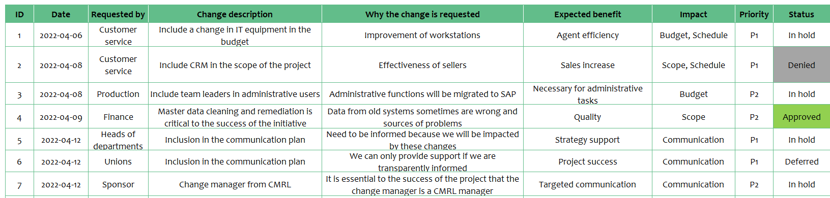
Change Requests Validation
* see "Change requests register" for more details

Slide 14

Questions?
The project team will be happy to answer all questions, comments and suggestions

Slide 15
Next meetings
Next steering committee meetings :
2022-10-29
2022-11-26
2022-12-17

